Slide 1
Class (external)
Education

Slide 2
Key content
Cultural deprivation 4
Material Deprivation 11
Cultural Capital 14

Slide 3
External factors
Elements from outside school environment which effect educational achievement

Slide 4
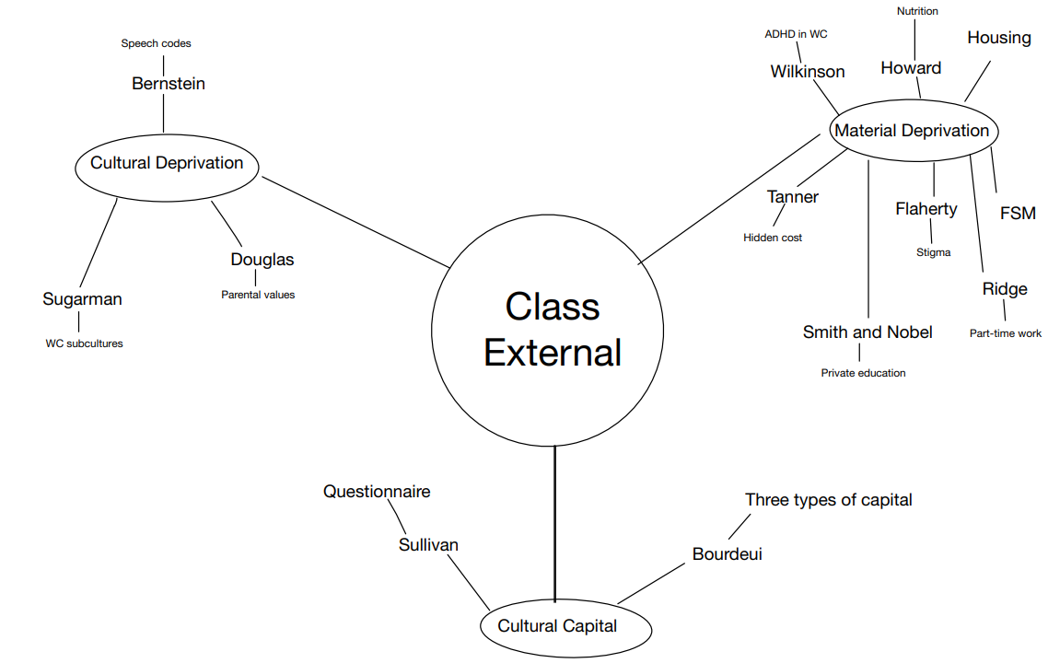

Slide 5
Cultural deprivation
Having inferior norms and values, skills and knowledge that make it difficult to access education.
- Experienced by Working class

Slide 6
Restricted code - Bernstein
‘innit’
‘rizz’
‘low key’
‘sus’
‘Down the apples and pears’

Slide 7
BERNSTEIN – ‘speech codes’
Cultural deprivation
Working Class DISADVANTAGE (born into restricted code/ not elaborated)
Restricted code (WC) = suitable for insiders/ close tight-knit group
  Working class -> limited vocabulary/ short unfinished sentences/ Grammatically simple/ more idioms/ more colloquial
Elaborated code (MC) = explicitly + clear (understood by all/ strangers understand it) – IDEAL PUPIL
  Middle class -> wide vocabulary/ grammatically complex/ varied and abstract/ context free
  Used by teacher/ textbooks/ exam
  Students who used elaborated code found better social mobility and opportunities
WC performed poorly in language-based subjects (English) due to their restricted code

Slide 8
Douglas – parental value of education
Working-class parents place less value on education
Less ambitious for children
Parents give children less encouragement to participate educational activities (homework/ revision)
Many working-class parents do NOT attend parent’s evening
Working-class parents may need to work instead
May encourage children to work rather than do school-work
Practical view of education rather than value

Slide 9
Sugarman – barriers to achievement
Working-class Subcultures -> act as barrier to educational achievement for working class pupils
Fatalism
Collectivism
Immediate gratification
Present-time orientation
Nothing you can do to change your status
Ascribed rather than achieved status
WC children did NOT believe education could help them in life
WC children accept they will go into working class jobs which require no qualifications
Do NOT believe in meritocracy
Valuing being part of a group rather than being an individual
Loyalty to the group
Education system demands individual aspiration
Willis – ‘learning to labour’ (12 WC lads)
Peer pressure
Seeking pleasure NOW rather than making sacrifices in order to get rewards in the future
School values delayed gratification (waiting for results)
WC students leave school early to earn money rather than staying for higher level qualifications (16-19) which would allow them to gain higher paying job
Seeking present as more important than the future
No long-term goals

Slide 10

Sugarman mnemonic
Fatalism
Collectivism
Immediate Gratification
Present-Time Orientation
Ferrari’s
Charles
Is Great
Proof They’re
Outstanding

Slide 11
Material Deprivation
NOT having the resources available to do well in school
Linked to poverty
Practical rather than cultural

Slide 12
Housing
Nutrition + Health
WC children have lower intakes of energy/ vitamins/ minerals – Howard
Poor nutrition affects health -> weakens child immune system -> results in more health problems -> results in more absences from school
WC families reliant on ready-meals/ takeaways (lack nutrients)
Wilkinson – higher rate of hyperactivity + ADHD amongst 10yo WC -> lead to issues in school
22.5% children on FSM (2021)
Shared Room - interrupted sleep
Homework/ Revision in shared space (kitchen) – interrupted homework
Damaged/ unsafe housing (e.g., leaking roof)
Lack of space for developmental play
Indirect effect in child’s health/ welfare -> cold + cramped housing causes ill health

Slide 13
Cost of Education
No/ limited access to computers (harder to homework)
Uncomfortable uniform (hand me down/ grown out)
Ridge - Need to get a part-time job to contribute to household (less time to do school-work)
Struggle to afford books/ revision resources
Harder to get to school (transport)
Tanner – cost of transport/ books/ computers/ uniforms/ equipment + field trips -> heavy burden on WC families (hidden cost of education)
Flaherty – stigma attached to FSM prevents some from taking entitlements
Smith and Nobel – WC pupils at disadvantage as cannot afford private education

Slide 14
Cultural Capital
BORDIEU
- Superior norms and values, skills and knowledge held by Middle Class given MC students an advantage

Slide 15
Bourdieu + Capital
Three interlinked types of capital (combine material + cultural factors) – explain why MC students do better than WC counterparts
  Cultural Capital – knowledge/ attitudes/ values/ language + abilities of MC
  Economic Capital – money and household income
  Educational capital
MC have economic capital (money) to provide cultural experiences – e.g., holidays abroad (languages) and museum trips –> leads to academic achievement + Educational Capital
Economic Capital can be used for private schooling + tutors to increase academic achievement

Slide 16
Alice Sullivan (2001)
Questionnaire to assess students' cultural capital
465 students completed questionnaire across 4 school
Students how showed greater cultural capital had graduates as parents + more likely to succeed at GCSE
Cultural capital only a PART of reason for differences by social class (resources/ greater aspirations also have a BIG impact)

Slide 17
Outline two factors external to schools that may affect social class differences in educational achievement.
4 marks.
Class (external)
Exam Question
17

Slide 18
Outline and Explain two cultural factors that may contribute to the poorer educational progress of some social groups in schools.
10 marks

Slide 19
Applying material from item A and your own knowledge, evaluate sociological explanations of social class inequalities in Educational Achievement.
ITEM A:
There are major differences in levels of Educational achievement between pupils from different social class backgrounds. Social class inequality in education begins even before children enter primary school, and in general the higher the social class of the parents, the more successful that children will be in education. There are a variety of material and cultural factors explaining this, both inside and outside of schools, as well as features of the school in process.

