Slide 1
Guess the sociologists
Class (external)

Slide 2


Sugarman
WC subcultures
(4 barriers to education)
fatalism/ collectivism/ Immediate Gratification/ Present-time Orientation

Slide 3


Sullivan
Questionnaire on cultural capital – only a part (other WC factors)

Slide 4

Douglas
Working Class Parental Values on Education
‹

Slide 5


Bernstein
Speech codes (restricted vs elaborated)
Ste

Slide 6

Flaherty
Stigma attached to FSM
Fla
t

Slide 7

Ridge
Part-time work to contribute to household

Slide 8
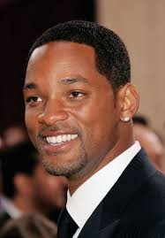

Smith and Nobel
Private Education advantage

Slide 9
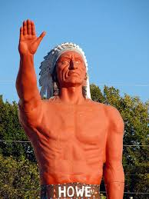

Howard
WC lower intake of energy/ vitamins/ minerals

Slide 10


Wilkinson
Higher rate of ADHD in WC 10yo

Slide 11
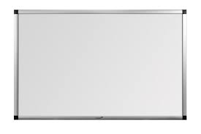

Bourdieu
Three types of capital (cultural/ economic/ educational)

Slide 12
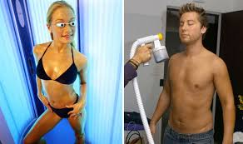
Tanner
Hidden Cost of education (transport/ books/ computers/ uniform/ equipment/ field trips)

